Slide 1
GIT Training
        Presented By:-Neeraj Virmani

Slide 2
A Brief History of Git
Linus uses BitKeeper to manage Linux code ran into BitKeeper licensing issue
  Liked functionality
  Looked at CVS as how not to do things
April 5, 2005 - Linus sends out email showing first version
June 15, 2005 - Git used for Linux version control

Slide 3
Traditional Version Control System
  Server with database
  Clients have a working version
  Centralized
  Examples
  CVS
  Subversion
  Challenges
  Multi-developer conflicts
  Client/server communication

Slide 4
Distributed Version Control -:
Every working checkout is a repository
Get version control even when detached
Git is decentralized repository system. If many people are working on a project, they each can have their own copy of centralist repository as a local repository. They can work individually without being connected to a central network (even with no connectivity), and can just push to the project when they are ready.

Slide 5
Advantages of Using Git
Free and open source : Git is released under GPL’s open source license. It is available freely over the internet.
Fast and small :- As most of the operations are performed locally, it gives a huge benefit in terms of speed.
Implicit backup :- The chances of losing data are very rare when there are multiple copies of it. Data present on any client side mirrors the repository, hence it can be used in the event of a crash or disk corruption.
Security :- Git uses a common cryptographic hash function called secure hash function (SHA1), to name and identify objects within its database.
Easier branching :- branch management with Git is very simple. It takes only a few seconds to create, delete, and merge branches.

Slide 6
Install Git Client
•
Linux (Debian) - Command: sudo apt-get install git
•
Linux (Fedora) - Command: sudo yum install git
•
Mac - http://git-scm.com/download/mac
•
Windows - http://git-scm.com/download/win

Slide 7
Introduce yourself to Git
Enter these lines (with appropriate changes):
  git config --global user.name “Neeraj Virmani"
  git config --global user.email nvirmani@xavient.com
Note :- You only need to do this once as these are set globally.
If you want to use a different name/email address for a particular project, you can change it for just that project
  cd to the project directory
  Use the above commands, but leave out the --global

Slide 8
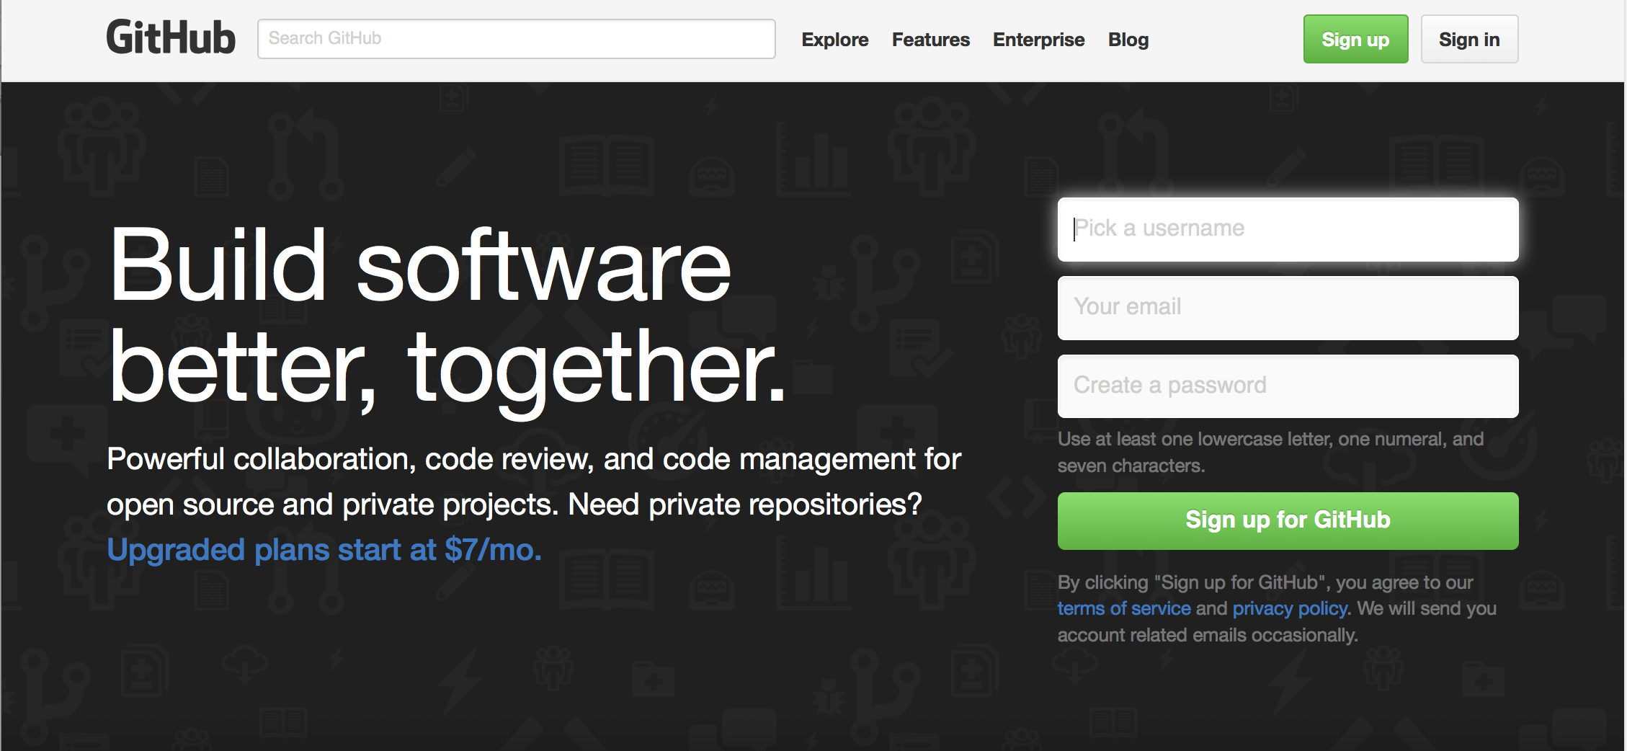
Create GitHub Account
www.github.com
Free for public repositories

Slide 9
Local Repository :- Git provides the users with a private copy of the whole repository. Users can perform many operations with this repository such as add file, remove file, rename file, move file, commit changes, and many more
Working Directory :- The working directory is the place where files are checked out and users can preform the work.
Staging Area :- Only those files present in the staging area are considered for commit to the local repository and not all the modified files.
Remote repository :- are versions of your project that are hosted on the Internet or network somewhere e.g. Github.

Slide 10
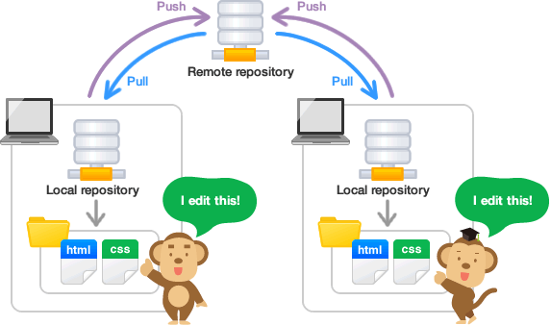
Slide <number>

Slide 11
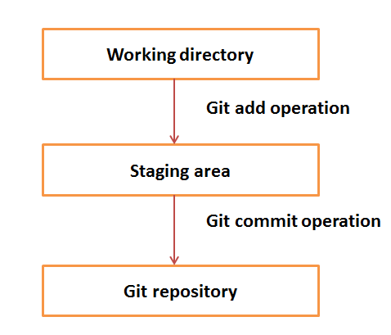
Basic workflow of Git
Step 1 : You modify a file from the working directory.
Step 2 : You add these files to the staging area.
Step 3 : You perform commit operation that moves the files from the staging area. After push operation, it stores the changes permanently to the Git repository .

Slide 12
Suppose you modified two files, namely “sort.c” and “search.c” and you want two different commits for each operation. You can add one file in the staging area and do commit. After the first commit, repeat the same procedure for another file.
[bash]$ git add sort.c # adds file to the staging area
[bash]$ git commit –m “committing sort,c”
[bash]$ git add search.c # adds file to the staging area
[bash]$ git commit –m “committing search.c”
[bash]$ git push origin master # Push the changes to the remote repository

Slide 13
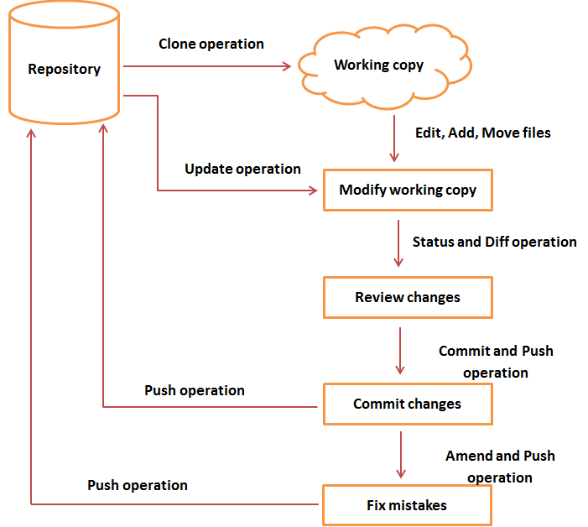
Git - Life Cycle

Slide 14
Cloning Remote repository
Git Clone :- Create a local repository on the terminal from the remote repository.
Syntax :- git clone <repo_URL>
E,g.
bash$ git clone https://github.com/neerajv/xavient.git .
Cloning into '.'...
remote: Counting objects: 3, done.
remote: Total 3 (delta 0), reused 3 (delta 0), pack-reused 0
Unpacking objects: 100% (3/3), done.
Checking connectivity... done.

Slide 15
Git Pull
Git Pull:- Fetch latest code from the remote and auto merge it with working directory
It brings a local branch up-to-date with its remote version.
bash$ git pull
remote: Counting objects: 6, done.
remote: Compressing objects: 100% (4/4), done.
remote: Total 6 (delta 1), reused 0 (delta 0), pack-reused 0
Unpacking objects: 100% (6/6), done.
From https://github.com/neerajv/xavient
a9b9ba7..0faf8d5 master -> origin/master
Updating a9b9ba7..0faf8d5
Fast-forward
README.md | 4 ++++
training.txt | 1 +
2 files changed, 5 insertions(+)
create mode 100644 README.md
create mode 100644 training.txt

Slide 16
Git Push
bash:t$ touch localfile.txt (Create a new File)
bash:$ git add localfile.txt (Add file to Staging area)
bash:$ git commit -m "added a txt file“ (Commit file to the local repository)
[master 8574e1f] added a txt file
1 file changed, 0 insertions(+), 0 deletions(-)
create mode 100644 localfile.txt

Slide 17
Push the changes to the Remote repository :-
bash:$ git push origin master
Username for 'https://github.com': neerajv
Password for 'https://neerajv@github.com':
Counting objects: 2, done.
Delta compression using up to 8 threads.
Compressing objects: 100% (2/2), done.
Writing objects: 100% (2/2), 252 bytes | 0 bytes/s, done.
Total 2 (delta 1), reused 0 (delta 0)
remote: Resolving deltas: 100% (1/1), completed with 1 local objects.
To https://github.com/neerajv/xavient.git
0faf8d5..8574e1f master -> master
Slide <number>

Slide 18
Create and fill a repository
cd to the project directory you want to use
2. Type in git init , This creates the repository (a directory named .git)
3. Create few files here.
4. Type in git add . , This adds the files to the staging area.
  5. Type in git commit –m "Initial commit“ , This adds all your current files to the local repository

Slide 19
Add the SSH key to the github account :-
1) Browse to https://github.com/settings/keys -> New SSH Key
2) Copy the content of the file id_rsa.pub here.
Add remote repository to the working copy and Push code:-
git remote add origin git@github.com:neerajv/xavient.git
git push -u origin master

Slide 20
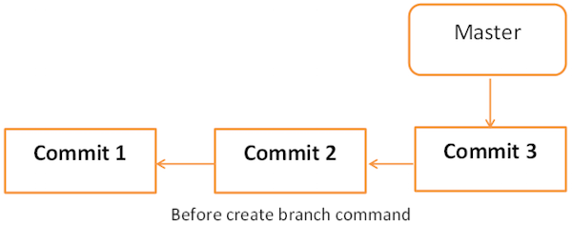
Git Branches
Branch :- Branch operation allows creating another line of development. We can use this operation to fork off the development process into two different directions.

Slide 21
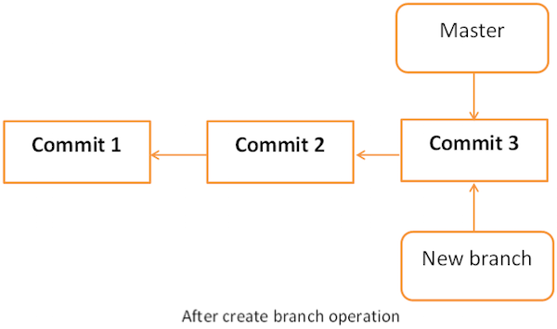
Create Branch :- bash$ git branch new_branch
View all Branches :-
bash$ git branch
* master
new_branch

Slide 22
Switch between Branches :-
bash$ git checkout new_branch
Switched to branch 'new_branch'
bash$ git branch
master
* new_branch
Delete a Branch :-
bash$ git branch
master
test_branch
bash$ git branch -D test_branch
Deleted branch test_branch (was 5776472).
(local branch deleted)
bash$ git push origin :test_branch
(remote branch deleted)

Slide 23
Git Merge
git merge <branch> Merge the specified branch into the current branch.
bash$ git checkout master
Switched to branch 'master'
bash$ git merge test_branch (Megre test_branch into master branch)
Updating 5776472..64192f9
Fast-forward
src/string_operations.c | 10 ++++++++++
1 files changed, 10 insertions(+), 0 deletions(-)

Slide 24
Git Tag
A lightweight tag is very much like a branch that doesn’t change – it’s just a pointer to a specific commit.
Creating and push tag in Git :-
git tag -a tag_name -m "any message" (create new tag)
git tag (display all tag which are created)
git push origin tag_name (pushing tag to remote repository)
Deleting tag in Git :-
git tag -d <tag_name> (deleted tag from local repo)
git push origin :refs/tags/tag_name (to delete tag from remote repo)

Slide 25
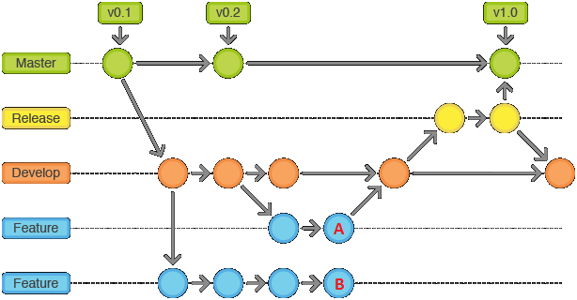
Git Flow

Slide 26
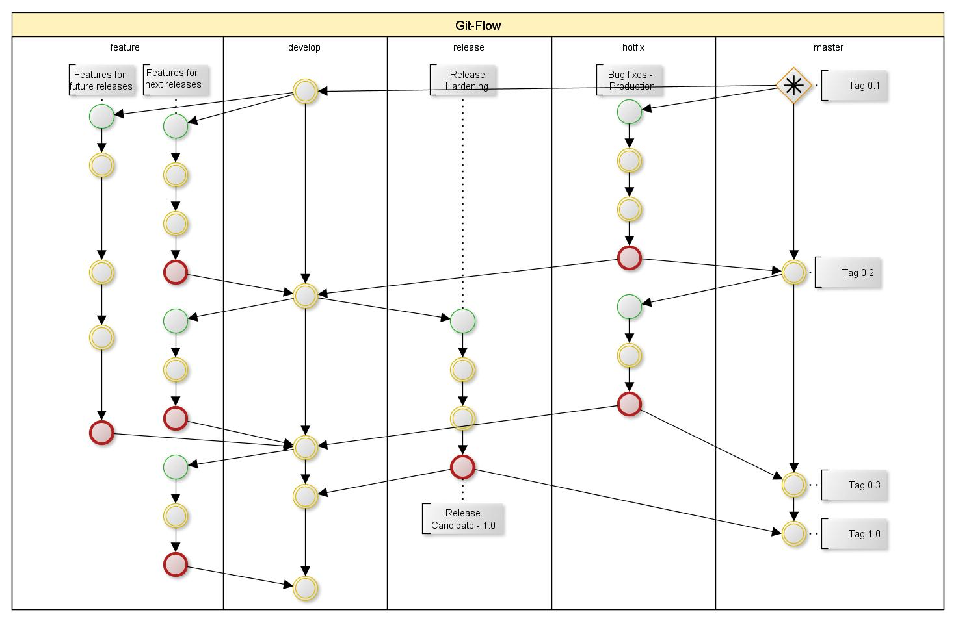
Git Flow

Slide 27
THANK YOU

